Slide 1
A Manifesto for the Future: My Hopes for the Post-Pandemic University
Dr. Brenna Clarke Gray
Coordinator, Educational Technologies
Thompson Rivers University
bgray@tru.ca // @brennacgray

Slide 2
My Territorial Journey
I join you today from my home in Tk’emlups te Secwepemc territory within the unceded traditional lands of Secwepemcúl’ecw (Secwepemc Nation), where I am an uninvited guest.
I moved here from nine years spent in the territory of the Qayqat First Nation, one of the smallest First Nations in Canada and the only registered First Nation without a land base.
I attended graduate school in territories associated with the Wabanaki Confederacy, the traditional homelands of the Wolastoq and Mi’kmaq peoples.
I was born, raised, and primarily educated in lands covered by the Upper Canada treaties and the territories of Algonquin Anishinabeg.
I am conscious of the privilege I embody in being free to move about these territories even as the original stewards of these lands await meaningful reconciliation with the settler state.

Slide 3
A Little Bit About Me
I spent nine years as a full-time English instructor at a community college before transitioning to faculty support.
I work at a regional university in a tenure-track faculty role, supporting a faculty complement of 500 with their digital teaching and learning needs.
I had been working as an educational technologist for about seven months when March 2020 hit.
I am very tired.

Slide 4
A Little Bit About the Work I Do
I run workshops on issues of digital pedagogy and good practice in teaching and learning online.
I help people design assessments for online modalities.
I support faculty projects using Mattermost, Wordpress, and other learning technologies.
I fix a lot (a lot) of Moodle shells.
And sometimes I work on my own projects: scholarly podcasting, open tenure processes, and edtech as care work.

Slide 5
How are you?
No, really. How are you?
Please share in the chat if you feel comfortable to do so.

Slide 6
Today’s Talk…
I’m going to talk about two key discourses that emerged over the course of the pandemic: care and surveillance.

Slide 7
Care …and co-option.

Slide 8
Care was the best discourse to emerge from the pandemic…

Slide 9
… but do you need another mindfulness webinar, or does your unit need adequate staffing?
Notes:
- Performative care and how our institutions use the discourse and language of care without making systemic changes.

Slide 10
Resisting neoliberal manifestations of care.
Care is not
something we do to enable more work to take place.
antithetical to notions of “rigour.”
the responsibility of the individual to undertake.
I have come to see these wellness webinars as positioning my exhaustion, my stress, my overwork as something I can solve on my own, with deep breathing or lunchtime yoga; they invite me to see my struggle as a personal failing.
I am not failing. I am being failed.

Slide 11
Gender & Society, “Who Does the ‘Housework of the University’ During a Pandemic? The Impact of Covid-19 on Precarious Women Working in Universities”
“Teaching and the accompanying administrative and pastoral work is considered less prestigious and beneficial to career advancement than research and publishing. Frontline engagement with students is the housework of the academy and it usually falls at the feet of women, women who are junior, women of colour and especially women who are precariously employed.”

Slide 12
The Tricky Truth About Care
Care is strategically useful to the institution to cultivate on the micro level, between individuals; consider how much institutional marketing in the pandemic hinged on celebrating the efforts of individual instructors and their efforts.
If individuals are enacting care, the institution can remain relatively indifferent to necessary structural changes.
But care ultimately fails on the macro level when it isn’t supported by institutional structures (eg. an understaffed support unit).
Care cannot be extracted in perpetuity.

Slide 13
A note on grace.
Are we bad at extending grace within the academy because we have not felt empowered to ask for it?

Slide 14
Surveillance … not just e-proctoring.

Slide 15
Why is surveillance tech so at home in our classrooms?
Vendors respond to needs educators express.
Proctorio, ClassDojo, Microsoft Habits, Zoom’s attention-tracking function: these tools are responding to existing anxieties institutions have about students.
Surveillance masquerades as care – I want to know my students are keeping up! – but it is in fact control. We monitor not for learning (none of these tools can measure learning), but for compliance.

Slide 16
What do we believe we are entitled to?
The lack of control over classroom space has led to an overreach re: what faculty are entitled to know about students.
Is it reasonable to exert control over:
Where and how students live and work?
Behaviour in the homespace?
When students complete their work?
E-proctoring tools and learning analytics offer us more information about our students’ private lives than we have had before. Why are we so willing to use it?
Consider the impact of implicit bias once we know what we know now.

Slide 17
This data is already being collected, so…
Would it be a welcome innovation for students to know how long an instructor spends marking an essay, what time they finish writing their lectures?
What about for Chairs and Deans to track and review that data?
As Audrey Watters and Cory Doctorow have both pointed out, surveillance was never intended to be for students alone.

Slide 18
How much harm is too much? How much harm is just enough?
Students in difficult living situations can find it hard to accommodate the needs of the e-proctoring tool.
Akash Satheesan’s research shows that e-proctoring tools struggle to treat students of all skin colours equitably.
Students report being unable to use the bathroom during exams.
Students with disabilities have reported issues with their needs being accommodated or their behaviour viewed as suspicious.
Gender-diverse students report problems being identified.
How much harm to marginalized students is acceptable collateral damage to the twin altars of Academic Integrity and Rigour?
Data supporting e-proctoring as a solution is limited.
Instructors can intercede, but we return to information and entitlement…

Slide 19
I hope the way forward embraces care and rejects surveillance.
These are not surface-level changes; they require renegotiations of what we see as the purpose and responsibility of our institutions.
This is more than a wellness webinar series and a cancelled contract.
What is care when it considers institutional responsibility?
What is a classroom without compliance?

Slide 20
What do you hope for?

Slide 21
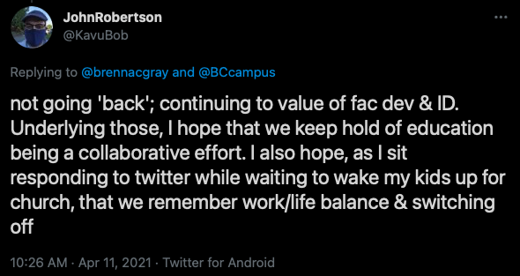
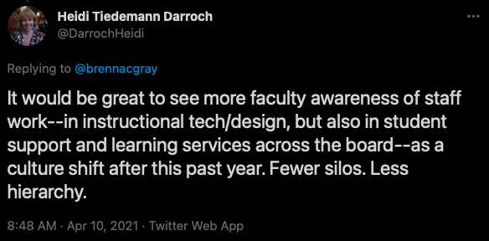

Slide 22
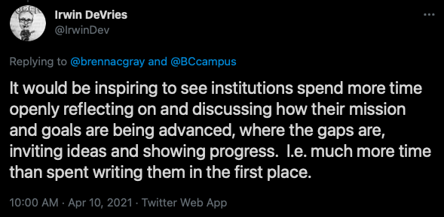
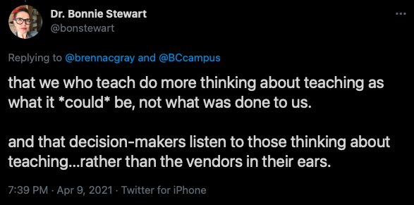
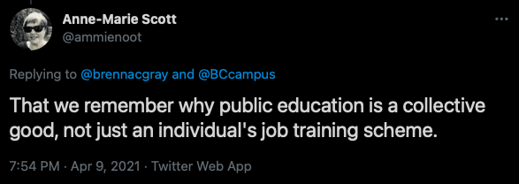

Slide 23
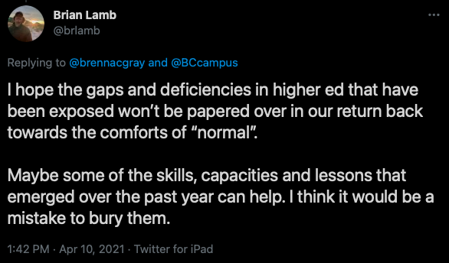
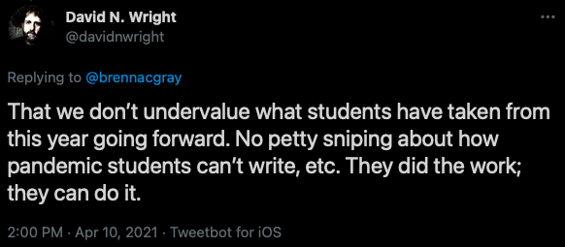

Slide 24
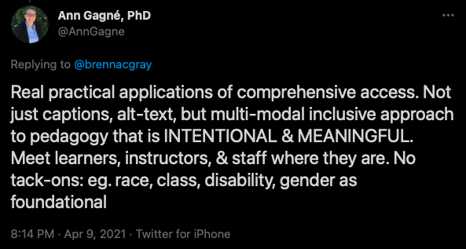
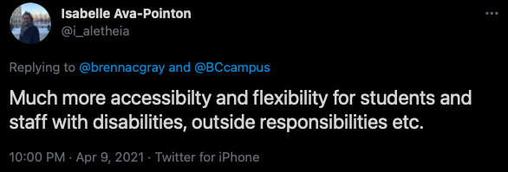

Slide 25
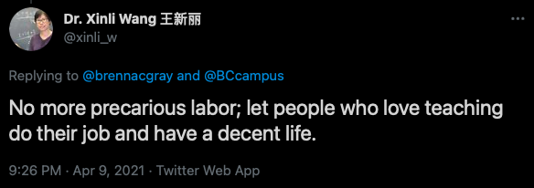

Slide 26
So. What’s next?

Slide 27
A Manifesto for the Future
We will build our universities on – and value – care.
We will centre issues of access and equity in everything we do.
We will extend grace and understand that we are likewise entitled to grace.
We will expect – and where necessary, demand – that our institutions respect the work of teaching and learning.
We will respect and celebrate the expertise within our walls.
We will trust our students and each other.

Slide 28
To me, this is a manifesto of openness.

Slide 29
Looking forward to your questions, thoughts, and shared experiences.
Please reach out to me about anything in this talk: bgray@tru.ca or @brennacgray on Twitter.

